Slide 1
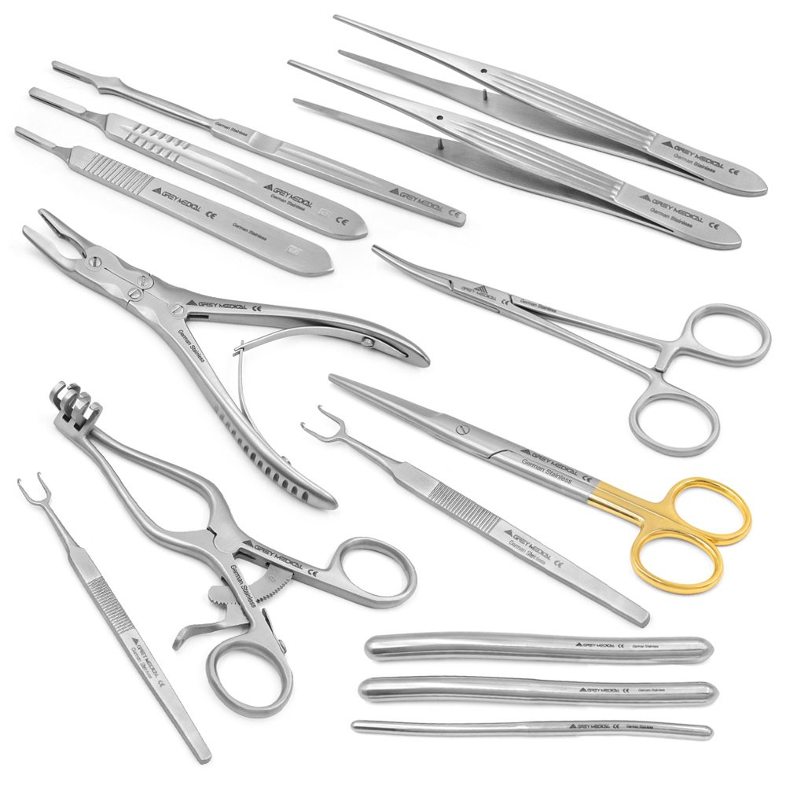
Surgical Instruments

Slide 2
Introduction
In the world of modern healthcare, the quality of surgical instruments plays a vital role in determining the success of surgical procedures. At GreyMedical®, we understand this critical connection and are committed to delivering excellence through innovation, precision engineering, and unmatched craftsmanship. As a privately owned medical technology company, our mission is rooted in enhancing surgical outcomes by providing premium-grade instruments that meet the highest industry standards.

Slide 3
Craftsmanship and Quality That Surgeons Trust
GreyMedical® surgical instruments are designed and manufactured with the surgeon’s needs at the forefront. Each instrument undergoes meticulous quality checks, ensuring durability, accuracy, and ergonomic comfort during use. Our team of engineers and artisans combines advanced technology with traditional precision handcrafting techniques, resulting in instruments that consistently perform under pressure in the operating room. From general surgery to highly specialized procedures, we deliver tools that meet the demands of medical professionals worldwide.

Slide 4
Innovation That Drives Better Surgical Outcomes
Innovation is central to everything we do at GreyMedical®. Our research and development team works closely with surgeons and medical professionals to design instruments that are not only effective but also intuitive and adaptable. Whether it’s creating more precise microscissors, enhancing suction systems, or developing advanced retractor systems, our goal is to make each surgical step smoother, safer, and more controlled. Our instruments support cutting-edge techniques in microsurgery, orthopedics, ENT, and cosmetic procedures.

Slide 5
Comprehensive Range of Surgical Instruments
At GreyMedical®, we offer an extensive selection of surgical instruments tailored for a wide range of medical fields. Our portfolio includes scissors, forceps, needle holders, retractors, clamps, and specialized tools crafted for both open and minimally invasive procedures. Each instrument is manufactured using high-grade stainless steel or titanium for optimal performance, longevity, and sterilization efficiency. We also provide customization options, ensuring surgeons have the exact tools they require for specific procedures.

Slide 6
Conclusion:
GreyMedical® stands as a trusted name in the surgical instruments industry, driven by a passion for innovation and precision. Our privately owned status allows us to prioritize quality, adapt to the needs of surgeons quickly, and invest in long-term development. Every instrument we create reflects our commitment to improving surgical outcomes and supporting healthcare professionals across the globe. When you choose GreyMedical®, you choose excellence, safety, and a partner dedicated to advancing surgical technology.

