Slide 1
Lodha
Hopefarm
Whitefield
A better rhythm for life in Bengaluru

Slide 2
Come home to a
better rhythm
Lodha Whitefield brings a calm, elevated home base to one of Bengaluru’s most connected urban destinations.

Slide 3
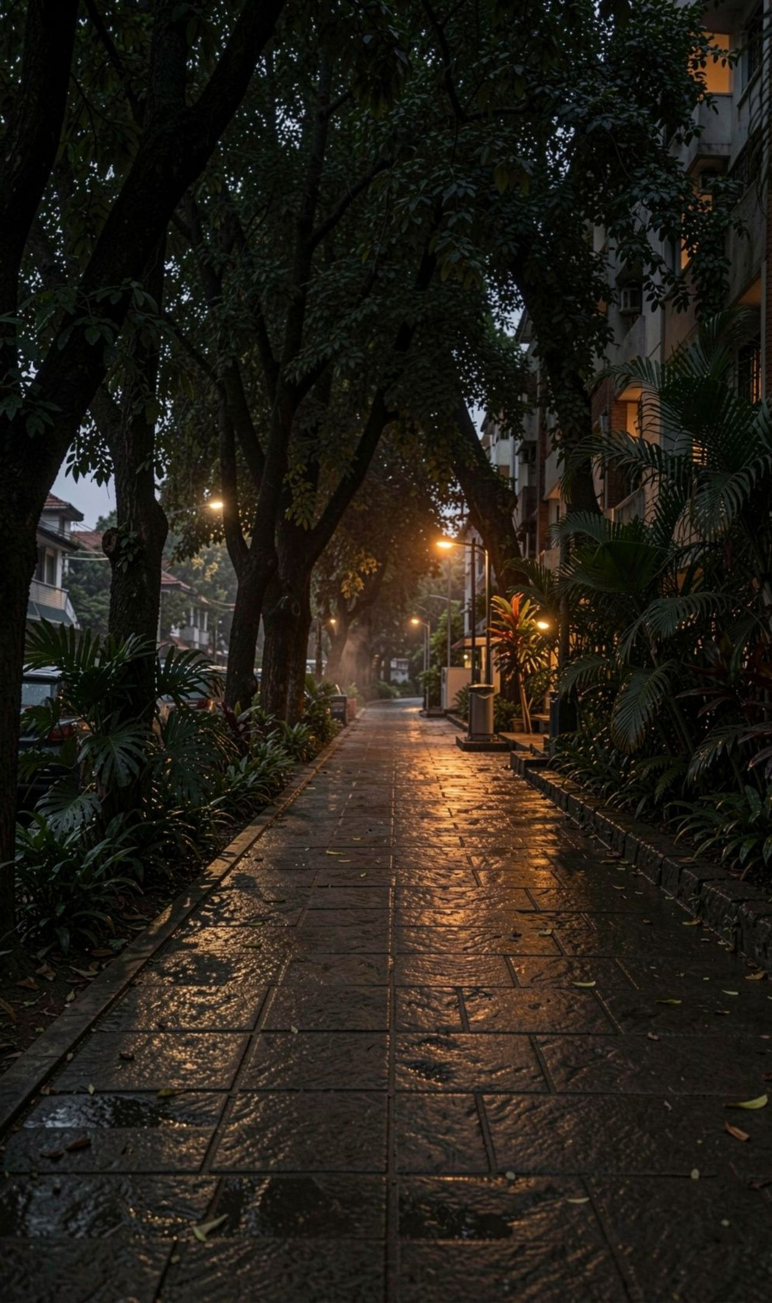
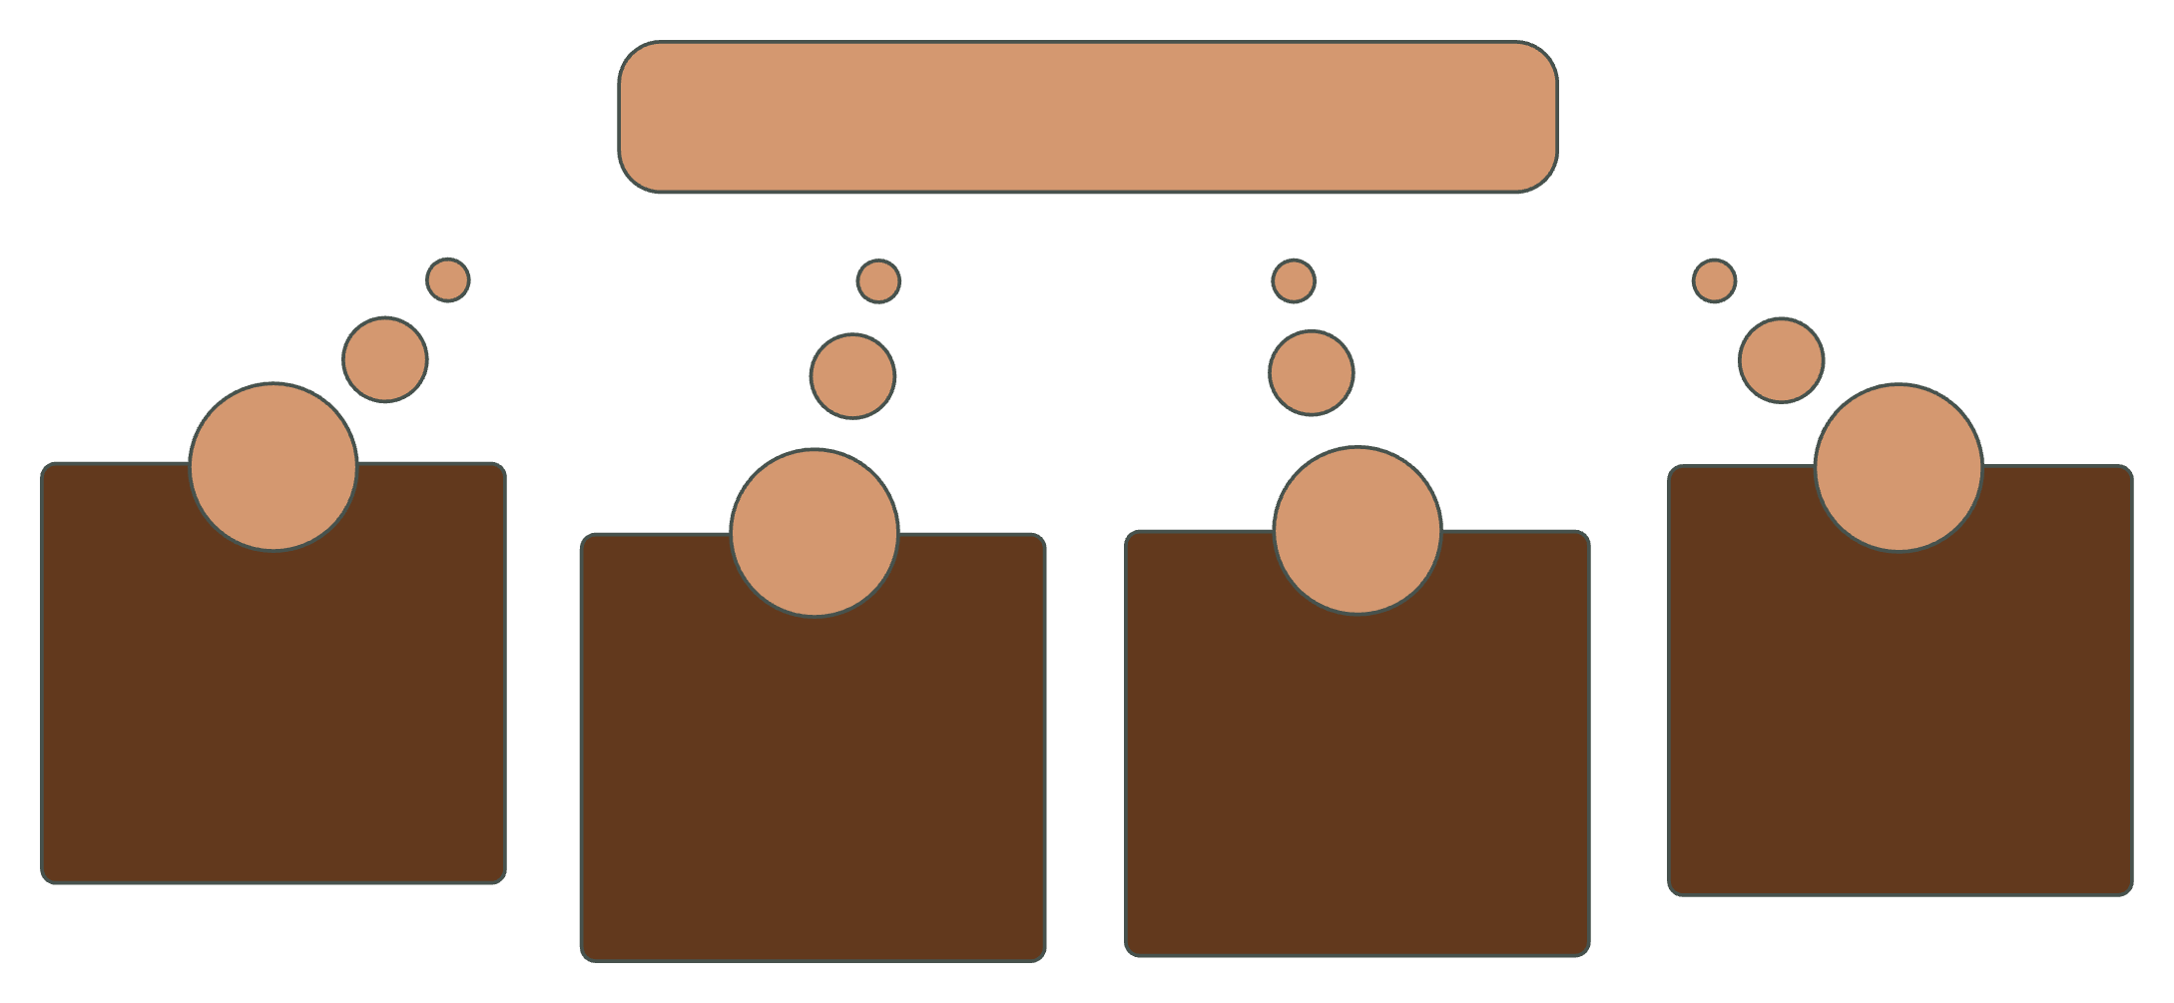




Everything important is closer than it feels
A connected address keeps the day moving lightly.
Lodha Whitefield
Hope Farm Metro
ITPB & Major Hospitals
1 min
ITPL Main Road
Google & Alembic City
1 min
about 10 min
5 min

Slide 4
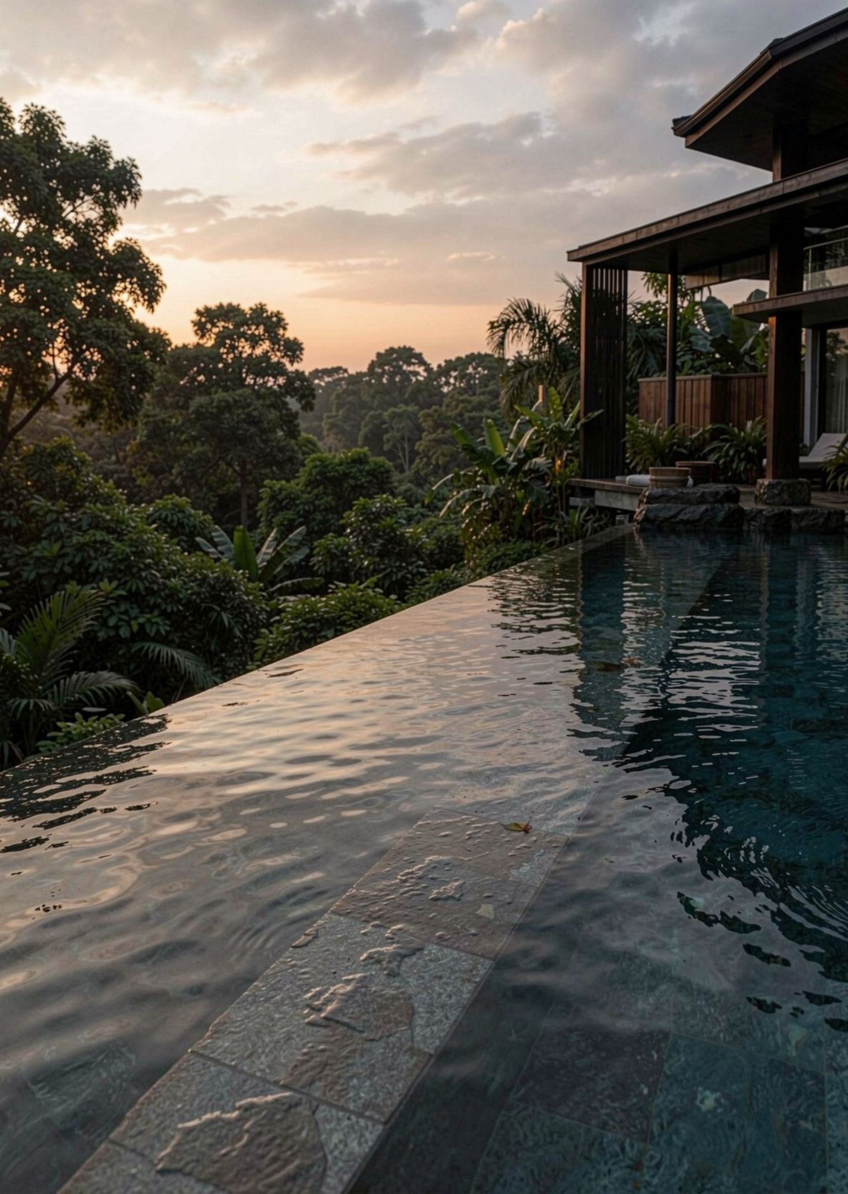
Resort-scale living, built into every day
50+
60%+
curated amenity experiences
open green landscape
for breathing room
across 8 acres
Clubhouse, infinity pool, spa and wellness, co-working lounges, and sports courts.

Slide 5



Hospitality is the detail you feel
Thoughtful, warm, and quietly present, Lodha’s service philosophy is designed around the everyday moments that make a home feel cared for.
In-house hospitality expertise
A considered standard of care, carried through the resident experience.
Care that shows up in the details
Curated gatherings, pristine shared spaces, and attentive resident care.

Slide 6
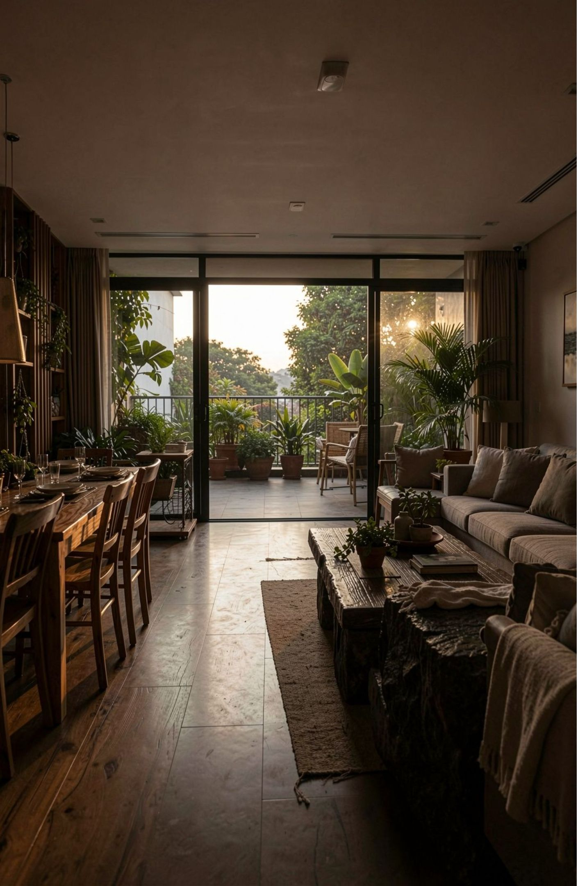
Space that gives family life room to unfold
Large-format living, dining, bedrooms, balconies, and natural light are central to the proposition.
3.5 BHK
4 BHK
5 BHK
~2,500
~3,000
~4,000
sq. ft.
sq. ft.
sq. ft.

Slide 7
Choose a life with
more room around it
A connected address. Generous private space. Resort-like amenities. A service culture designed for the way families live now.
Explore the residences and schedule a private conversation.
Lodha Hopefarm · https://www.prelaunchbangalore.in/lodha-hopefarm-junction-whitefield/

